Slide 1
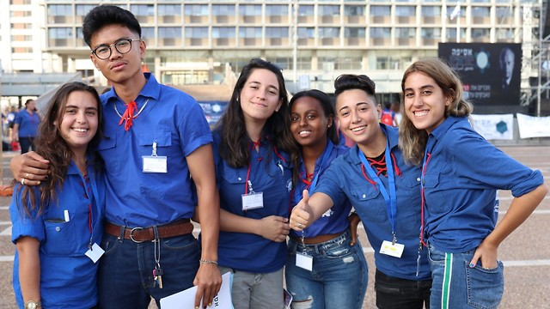
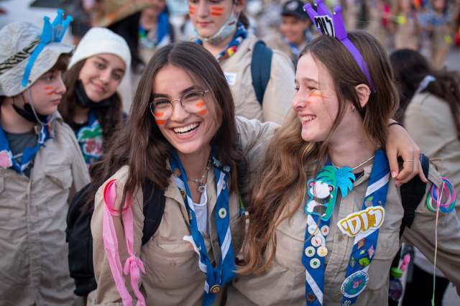
The Informal Code and Key Experiences
Naming the Intuitions
Koret International School for Jewish People's Studies
ANU – Museum of the Jewish People

Slide 2
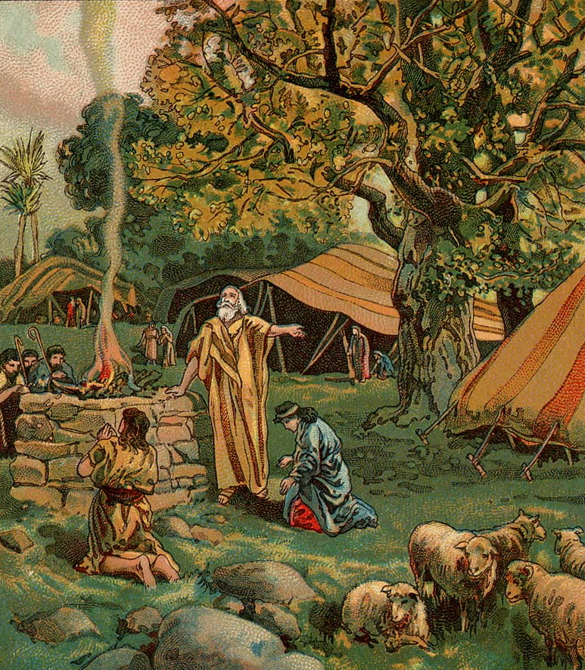
Opening Question
Why did God choose Abraham specifically?

Slide 3
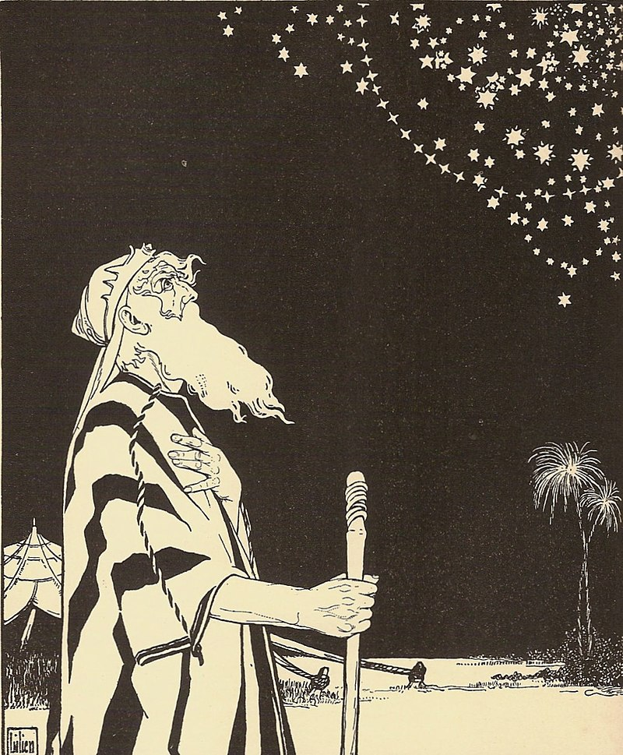
Strange Answer
"And when Abraham came and looked, saw, investigated, understood, engraved, hewed, combined, and formed, and it succeeded for him — the Master of All revealed Himself to him, took him to His bosom, kissed him on his head, called him His beloved, named him after His own name, and made a covenant with him and with his descendants forever."
(Sefer Yetzirah, 6:8)
But how can we as educators make our students/youth curious like Abraham?

Slide 4
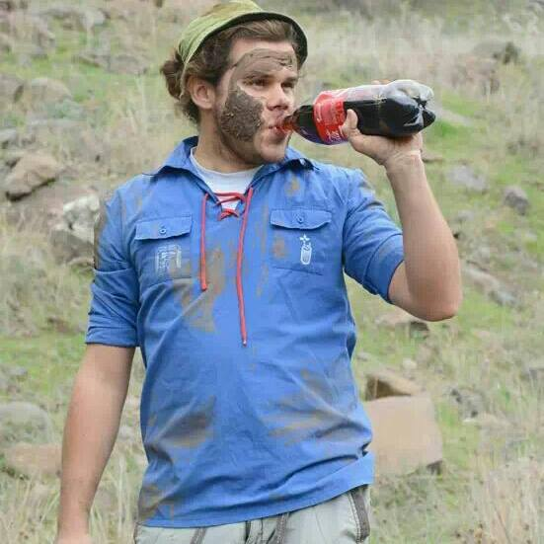
A Little About Me

Slide 5
Who here was a member of a youth movement or youth organization?
What was your most meaningful experience there?

Slide 6
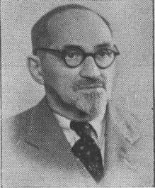
Youth
"Only in modern societies can we identify a clear and comprehensive classification of youth. The category 'adult' is not a parallel category to 'youth,' but rather an entirely separate dimension or category. A 'adults' movement never developed in modern society.”
(Shmuel N. Eisenstadt)

Slide 7
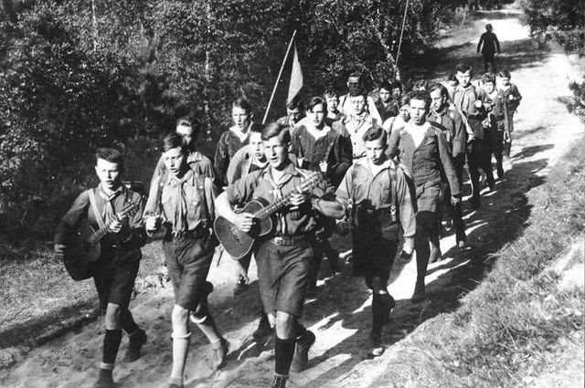
Wandervogel - Wandering Bird
"In 1896, among parts of the student youth in Germany, a 'wandering' movement began, aimed at developing the life forces of young people and returning them to the German landscape, distancing them — if only temporarily — from the city and the middle-class patterns of their parents' generation. This movement, known as 'Wandervogel' (wandering bird), quickly spread throughout Germany, with other movements joining later.
Youth movements were already complaining at the time about several manifestations of what we now call human alienation in the city, caused by technology and rationalist industrial society and its one-sided emphasis on intellectual development in school. The longing of youth was for a new form of life that would liberate from alienation and develop all the powers of the soul.
[They believed that] human responses to real-world challenges are influenced and guided by 'mental attitudes.' As the most effective means of influencing 'mental attitudes,' youth movements saw indirect education methods, using suggestion and symbol, above all — through emotional inspiration.”
(Chaim Shatzker, 1973)

Slide 8


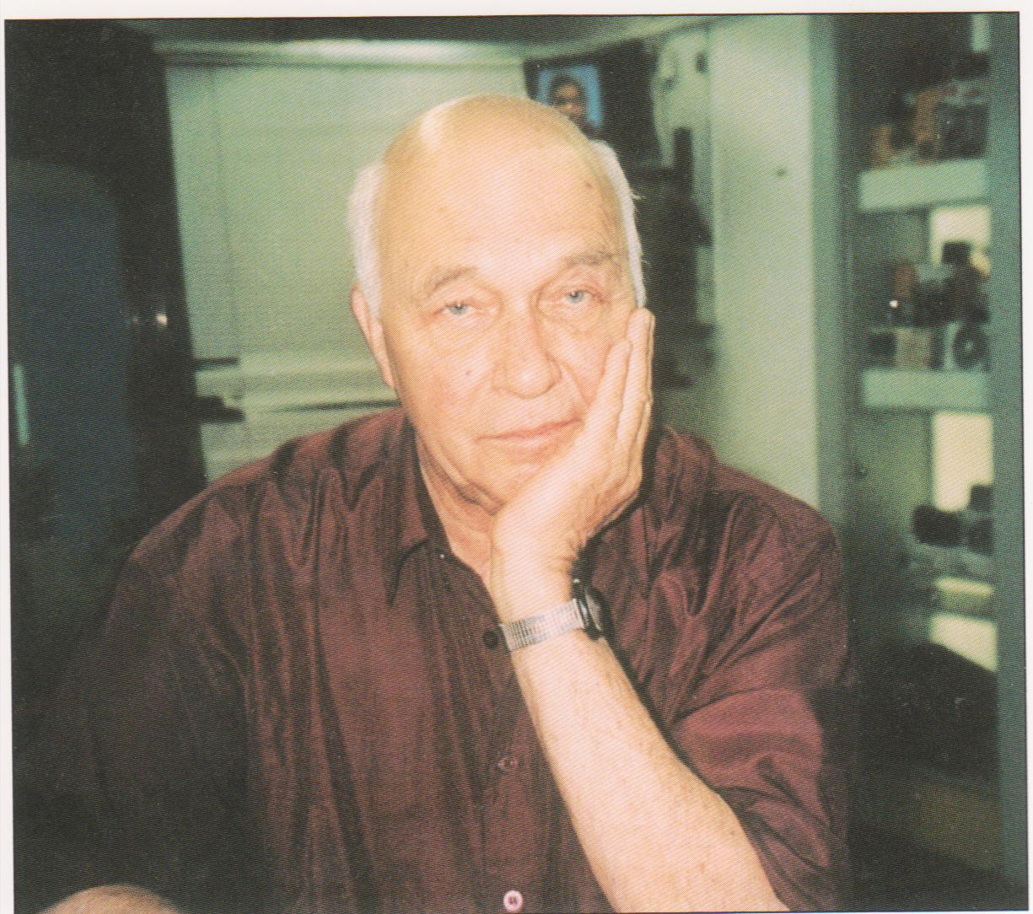


Developing the Informal Code Code
A system of explicit social conventions through which the conversion of the unknown into the known is made. Alternatively, a code is a basic set of rules underlying concrete conventions and behaviors, giving them meaning, setting a value standard, and serving as a medium of exchange.”
(Reuven Kahana, 2000)
We will now go through the components of the code. If you experienced or facilitated an activity with this component, write down the component's name and the activity.

Slide 9

1. Voluntarism
Free choice regarding joining, leaving, and participating in activities within the framework, such that the future "cost" of such decisions is minimal.

Slide 10
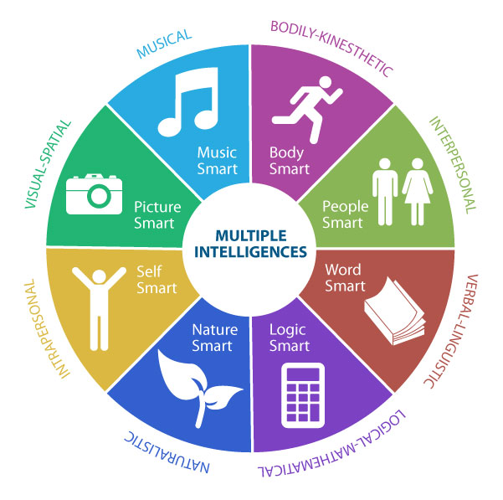
2. Multidimensionality
A broad range of fields of activity and diverse skills, equal in importance and social value.

Slide 11

3. Symmetry
Reciprocal interaction based on equal resource relationships, mutual coordination of principles and expectations, with no possibility of coercion on either side.

Slide 12

4. Dualism
The simultaneous existence of opposing trends, such as belonging and achievement, competition and cooperation.

Slide 13

5. Moratorium
Temporary deferral of commitments and decisions, allowing extensive trial-and-error both within and outside institutional boundaries.

Slide 14

6. Modularity
Eclectic structuring of activity, done according to changing circumstances and interests.

Slide 15
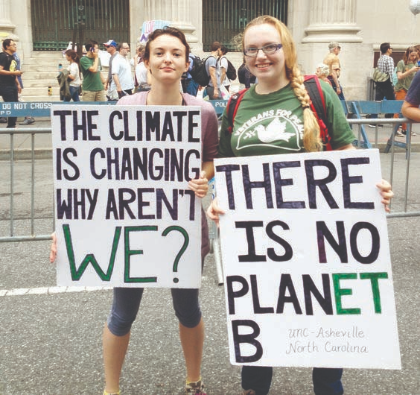
7. Expressive Instrumentalism
(Also called: a combination of instrumental and expressive orientation) — A fusion of expressive activity, with immediate reward, and instrumental activity aimed at achieving future results.

Slide 16

8. Pragmatic Symbolism
Attributing symbolic meaning to actions and/or converting symbols into deeds.

Slide 17
How many components of the code did you experience in the course of your work in education?
Both as educators/teachers and as students/youth.

Slide 18
The Informal Code – A Generative Theory
Economic corporations, political parties, volunteer organizations, schools, and more
Youth in Postmodern Society
Boarding Education
Yossi Soroker (2010) Yehezkel Dar (2012)

Slide 19
Try to think of an educational experience or encounter with an educational figure that changed something in your worldview or life path.

Slide 20
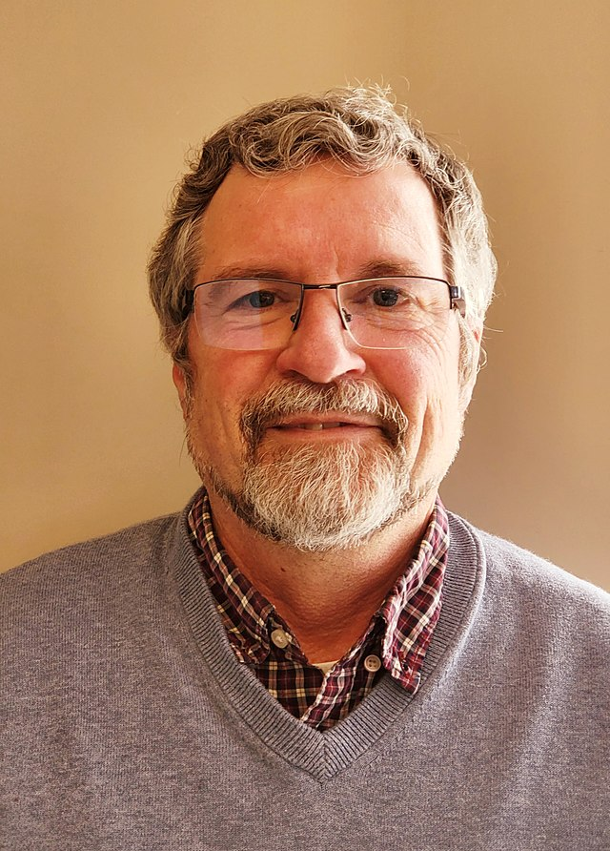
From Key Experiences to Turning Points
"The most prominent features of key experiences were the authenticity of the organizers or of the content, the relevance of the activity to participants' lives, the challenge it posed, the competitiveness, the surprise, and the element of choice. All of these recurred in many key experiences — in the family, in schools, in non-formal settings, and in the military.”
(Gad Yair, 2006)

Slide 21

Quote from the Book
"He suddenly took a flashlight and said to me: 'You're a woman and you're screwed because of that, you're Mizrahi and you're screwed because of that, you're from south Tel Aviv and you're screwed because of that; and there's nothing to be done, unless you fight.' We used to leave his classes shaken. He created an event in the classroom and made me feel that something real was happening, that it was worth dying for something… He was the first man who made me feel that I was finally ready to fight for something, and that something was my place."
(One of the interviews in the book. Cited in: Gad Yair, 2006)

Slide 22
The Informal Shall Become Creative
"And when Abraham our father came and looked and saw and investigated and understood and carved and carved and joined and formed and ascended with his hand, the Lord of all appeared to him, sat him in his bosom and kissed him on the head, called him his beloved and named him by his name, and made a covenant with him, to him and to his seed after him forever."
(Book of Creation, 6:8)
"How difficult it was to conclude from this concept that informal action is actually the action practiced among the human world from the beginning of its existence, long before the existence of fixed formulas and formulas of any kind. How difficult it was to understand that the very idea that stands for this mode of action and thought far precedes the formation of formal modes of thought and action."
(Shani Oren, 'The informal will be creative')

Slide 23

Thank You!

